Slide 1
Topic: Adding and Subtracting Fractions
EQ: What is the written model for adding and subtracting fractions?
Ms. Latham

Slide 2

Topic: Adding and Subtracting Fractions
EQ: What is the written model for adding and subtracting fractions?
Denominator relationship
Thinking back to our pictures what was our solution for:
$$\frac{1}{5}+\frac{1}{3}=\frac{}{}$$
What pattern do we notice?????
Notes:
Come up with the pattern as a class (i.e. the denominator of the answer is the denominators of the others multiplied together)

Slide 3
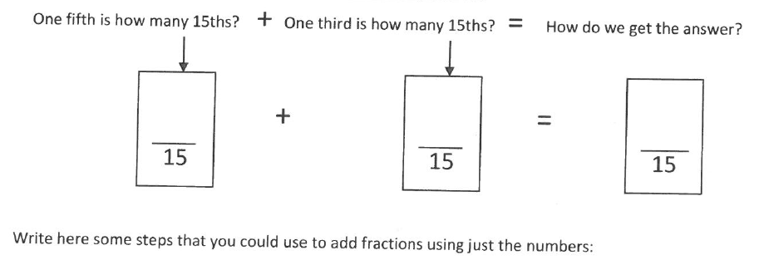

Topic: Adding and Subtracting Fractions
EQ: What is the written model for adding and subtracting fractions?
$$\frac{1}{5}+\frac{1}{3}=\frac{}{}$$
Using equivalent fractions
Notes:
Leave this slide up and give out the 2nd page of the Written Method WS

Slide 4
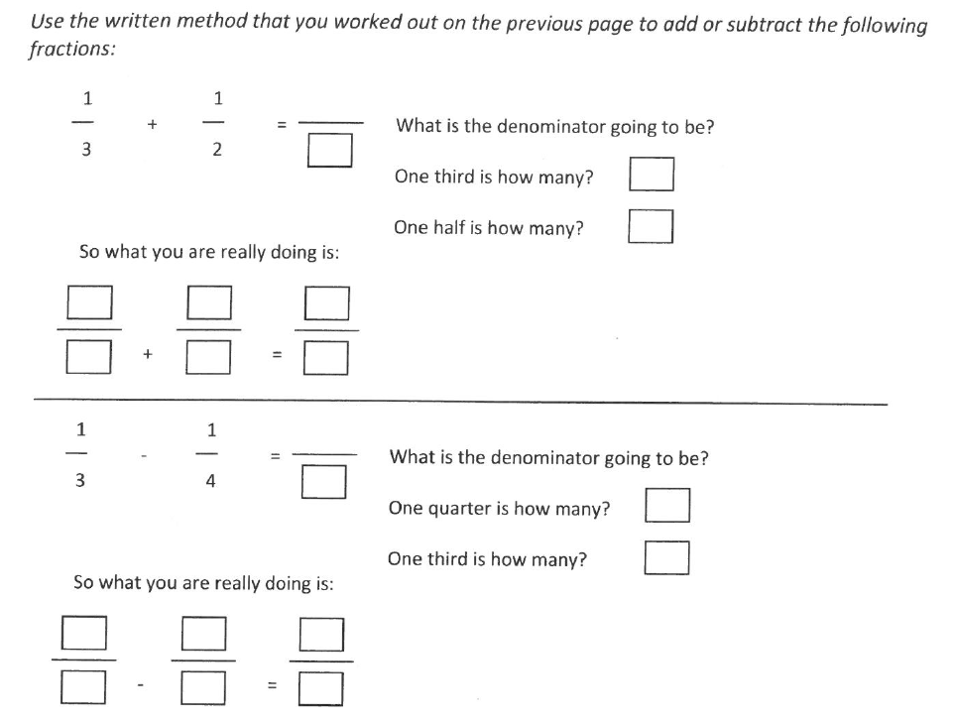

Slide 5
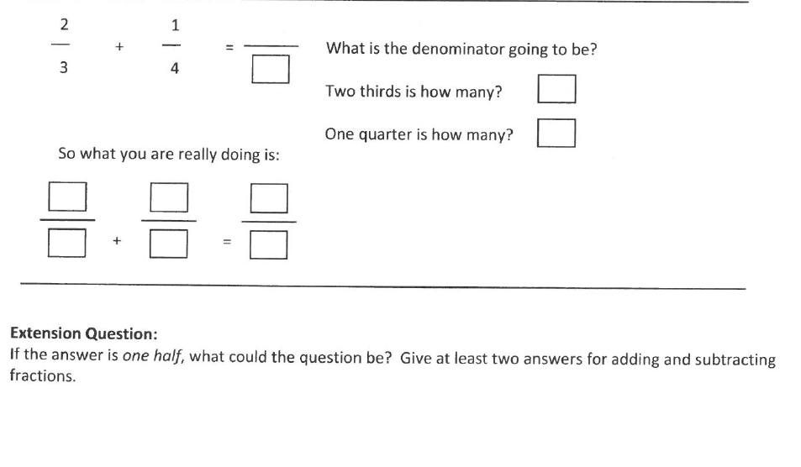

Slide 6
Summary
To add and subtract fractions we need to first _______________________, then we need to _____________ the numerators.

